Slide 1
SMART CLASSROOM AND TIMETABLE SCHEDULAR
Review-1
Batch Number:
Under the Supervision of,
Mr. Laxman
Professor / Associate Professor / Assistant Professor
School of Computer Science and Engineering
Presidency University
Roll Number | Student Name
20221COM0017 | Nishanka M
20221COM0031 | Krishna Sai
20221COM0034 | Sunil Kumar Pandab
Name of the Program: Computer Engineering with specialization in Artificial Intelligence and Machine Learning
Name of the HoD: Dr. Gopal Krishna Shyam
Name of the Program Project Coordinator: Ms. Sumitha Guddin
Name of the School Project Coordinators: Dr. Sampath A K , Dr. Geetha A

Slide 2
Problem Statement Number: 25028
Organization: Smart Education
Category (Hardware / Software / Both) : Software
Problem Description:
Background
Higher Education institutions often face challenges in efficient class scheduling due to limited
infrastructure, faculty constraints, elective courses, and overlapping departmental requirements. Manual
timetable preparation leads to frequent clashes in classes, underutilized classrooms, uneven workload
distribution, and dissatisfied students and faculty members. With the increasing adoption of
multidisciplinary curricula and flexible learning under NEP 2020, the class scheduling process has
Become more complex and dynamic, requiring intelligent and adaptive solutions.
Description
The current scheduling mechanism in most higher education institutes/colleges relies on manual input
via spreadsheets or basic tools. These fail to account for real-time availability of faculty, room capacity,
teaching load norms, subject combinations, and student preferences. A solution is required that will
accommodate the various parameters required for scheduling classes for UG and PG students and return
an optimized timetable ensuring:

Slide 3
*Maximized utilization of classrooms and laboratories
*Minimized workload on faculty members and students
* Achievement of required learning outcomes
Key Parameters
The following parameters can be taken into account as variables for creating optimized timetables:
Number of classrooms available
Number of batches of students
Number of subjects to be taught in a particular semester
Names of subjects
Maximum number of classes per day
Number of classes to be conducted for a subject per week / per day
Number of faculties available for different subjects
Average number of leaves a faculty member takes in a month
Special classes that have fixed slots in timetable

Slide 4
Content
Problem Statement
Objectives
Background and Related work for title Selection
Analysis of Problem Statement
Innovation or Novel Contributions
Git-hub Link
Timeline of the Project
References

Slide 5
Analysis of Problem Statement
1. Full Technology Stack
You can use this detailed list for the "Technology Stack Components" slide.
Frontend (Client-Side)
Core Framework: React v18.2 (Component-based UI architecture)
Language: Python
Styling: Bootstrap CSS v3.4 (Utility-first CSS framework for responsive design)
Routing: React Router DOM v6.21 (Client-side routing)
HTTP Client: Axios v1.6 (Promise-based HTTP client for API requests)
Linting: ESLint + TypeScript-ESLint (Code quality and consistency)

Slide 6
Analysis of Problem Statement (contd...)
Backend (Server-Side)
Runtime Environment: FastAPI (Python)
Web Framework: Next.Js
Language: Python
ORM (Object-Relational Mapping): Sql Alchemy
File Export Engines:
pdfkit v0.14 (PDF generation)
exceljs v4.4 (Excel spreadsheet generation)
Database & Security
Database: PostgreSQL (Relational Database System)
Authentication: JSON Web Tokens (JWT) v9.0 (Stateless authentication)
Encryption: Bcrypt v5.1 (Password hashing)
Environment Management: Dotenv v16.3 (Configuration management)

Slide 7
Github Link
Github Link
https://github.com/Sunil17120/Smart-classroom-and-timetable-schedular
Visibility : Public

Slide 8
Analysis of Problem Statement (contd...)
Software:
OS: Cross-platform (Windows/Linux/macOS) due to Node.js environment.
Database: PostgreSQL instance.
Client: Modern Web Browser (Chrome/Edge) with JavaScript enabled.
Hardware (Server):
RAM: Minimum 4GB (to handle in-memory timetable generation arrays).
CPU: Multi-core processor recommended for concurrent generation requests.

Slide 9
Analysis of Problem Statement (contd...)
Algorithm Approach: Randomized Heuristic Search (Greedy approach with multiple attempts).
Workflow:
Initialization: The system defines working days (Mon-Fri) and standard time slots (09:00 - 17:15).
Constraint Checking:
Capacity Check: classroom.capacity < requiredCapacity
Faculty Availability: Verifies maxClassesPerDay limits.
Conflict Detection: Uses a Hash Map (Map<string, Set<string>>)
to track occupied slots for Batches, Faculties, and Rooms in $O(1)$ time.
Scoring Function:
Score= 100 - (Violations * 10) - (Variance*2) + (Utilization*10)
Note: The formula above is derived from the logic in calculateScore method.
5.Genetic Algorithms (GA): Explain that the system "evolves" timetables over generations to find the most optimal one with zero clashes .

Slide 10
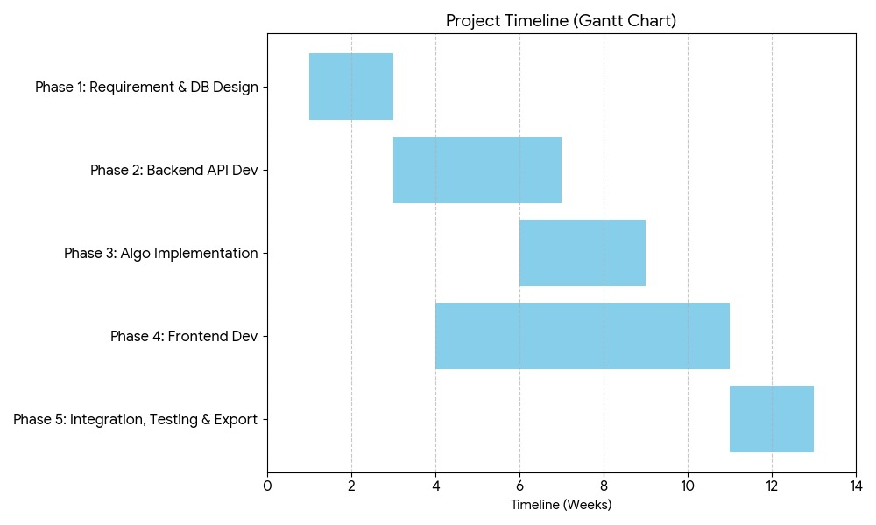
Timeline of the Project (Gantt Chart)

Slide 11
References (IEEE Paper format)
[1] S. A. K. Al-Hajri, "Automating Timetable Generation with Conflict Resolution Algorithms in Web-Based Systems for Educational Institutions," 2023 Intelligent Computing and Control for Engineering and Business Systems (ICCEBS), Bangalore, India, 2023, pp. 1-6.
[2] Z. L. Tan et al., "A Survey of University Course Timetabling Problem: Perspectives, Trends and Opportunities," IEEE Access, vol. 9, pp. 12111-12125, 2021.
[3] M. A. Al-Betar et al., "Automated Timetabling System for University Course," 2021 International Conference on Emerging Smart Computing and Informatics (ESCI), Pune, India, 2021, pp. 45-50.

Slide 12


